Slide 1
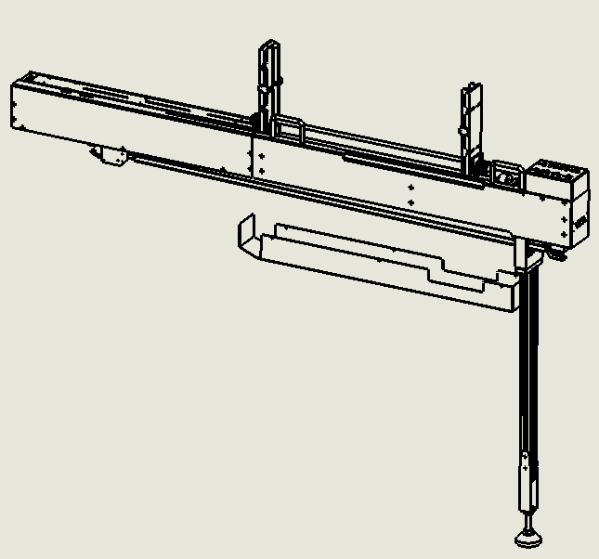
Shenzhen Southern Machinery Sales and Service Co.,Ltd
Add :Rm 1806,Block 3, Jinyun COFCO, Qianjin 2 Road,Xixiang,Baoan District, Shenzhen City, China
TEL: 0755-83203237; FAX:0755-23240492 website:www.smthelp.com
Stacked Tube Feeder Operation Instruction
Build No：20180901A03

Slide 2
Instructions
● This feeder is designed according to the requirements of your company and the performance of the machine. It is non-standard feeder.
●Feeder is powered by DC24, and cannot use too high or too low voltage, resulting in burn damage to control panels.
●It require the Air pressure > 0.6mpa. When it is less than 0.6mpa, the component will not put on the right position.
●Do not short circuit 24V and 0V connections, which will burn out all electrical components.
●Feeder can be carried out with the host. If communication is not conducted, the host may not be able to get components, and causing alarm ring out. When it connect(communicates) with the mounter ,it must offered 0V(GND).
●When feeder pushing the spring, the spring must be loaded with conponent or tube. It is not allowed that pushing spring by air, which will cause the spring bend.
●Feeder fiber head should be regularly cleaned with detergent (alcohol) to prevent dust.
●Feeder must be firmly installed, fly dhaka tightly locked lock after installed on the host.

Slide 3
Contents
Chapter 1：Feeder basic parameters, usage range, connector definition
Chapter 2：Spare Parts List
Chapter 3：Installed way
Chapter 4：Operation way
Chapter 5：Adjustment method
Chapter 6：Treatment of feeder faults
Chapter 7: Definition list of IO List & wiring
Chapter 8：Attachment--Instructions for use of fiber optic amplifier

Slide 4
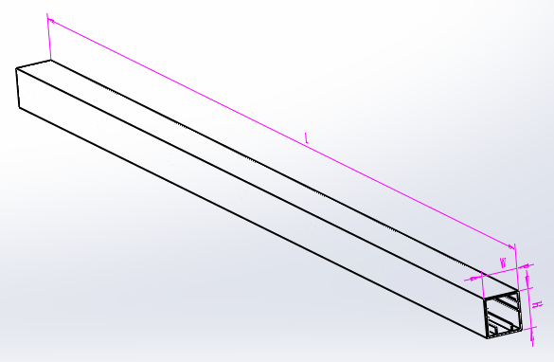
Chapter 1：Feeder basic parameters, usage range, connector definition
1：Feeder can adapt to the tube size specification：
min：LxWxH 300mmx6mmx10mm.
Max：LxWxH 600mmx30mmx30mm.
2：Voltage: DC24V.
3: Air pressure >0.6Mpa.
4:Signal communication：Pin 4 component in position

Slide 5
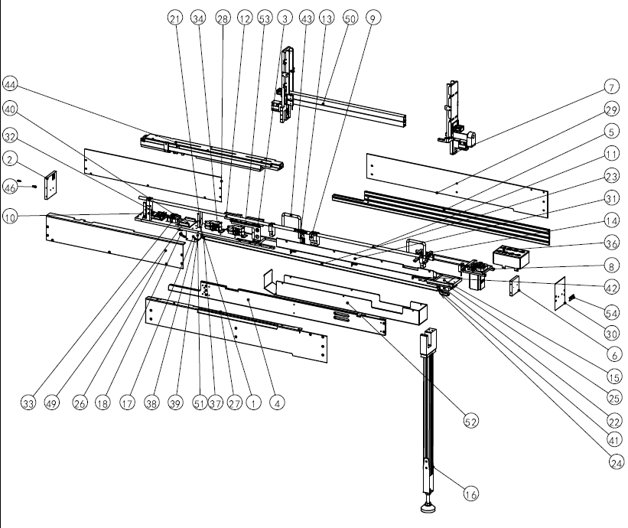
Chapter 2：Spare Parts List
Item No. | Part No. | Description | Qty
1 | 001 | New Feida floor | 1
2 | 002 | New vertical plate | 1
3 | 003 | Material tray support column | 6
4 | 004 | 10*70 profile | 1
5 | 005 | 10*70 profile -A | 1
6 | 006 | tube plug after loading fly up | 1
7 | 007 | ACTC6R tube mounted Feida rear vertical plate assembly | 1
8 | 008 | Motor driven spring assembly | 4
9 | 009 | Mounting bracket for spring collecting tube | 1
10 | 010 | New spring support assembly | 1

Slide 6
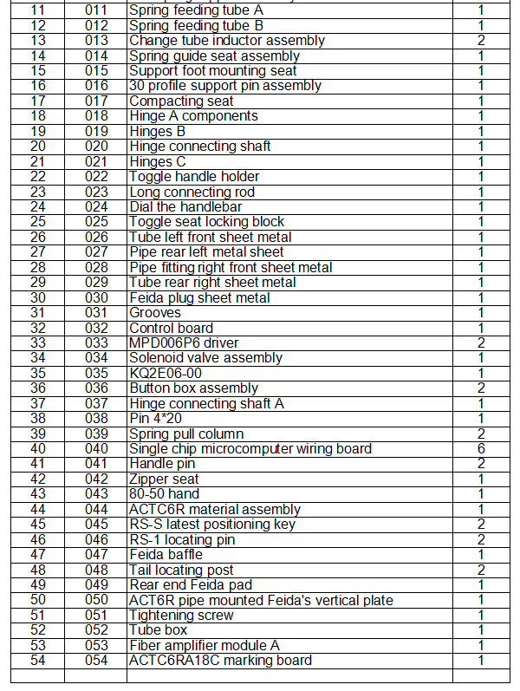
Chapter 2：Spare Parts List

Slide 7
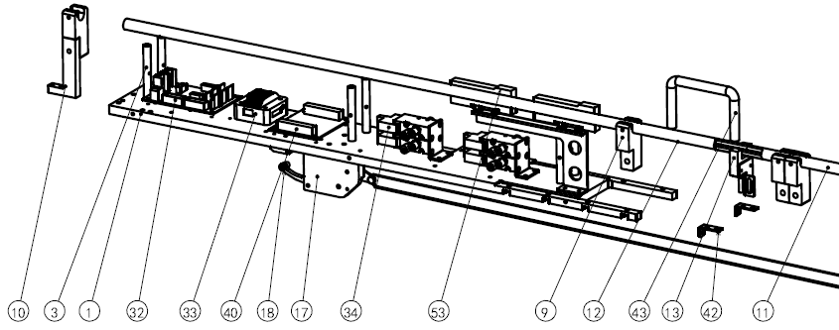
Chapter 2：Spare Parts List
Item No. | Desription | Part No. | Qty
1 | Feeder bottom plate-now | 001 | 1
3 | Support Prop of feed plate | 003 | 6
9 | Spring receiving tube mount bracket | 009 | 4
10 | Load spring bracket assembly | 010 | 1
11 | Spring collecting tube A | 011 | 1
12 | Spring collecting tube B | 012 | 1
13 | Change the tube sensor assembly | 013 | 1
17 | clamp base | 017 | 1
18 | chain assembly A | 018 | 1
32 | control panel | 032 | 1
33 | MPD006P6 Driver | 033 | 1
34 | solenoid valve group | 034 | 2
40 | MCU terminal board | 040 | 1
42 | Lanyards base | 042 | 6
43 | 80-50 puller | 043 | 2
53 | Fiber amplifier assembly A | 053 | 1

Slide 8
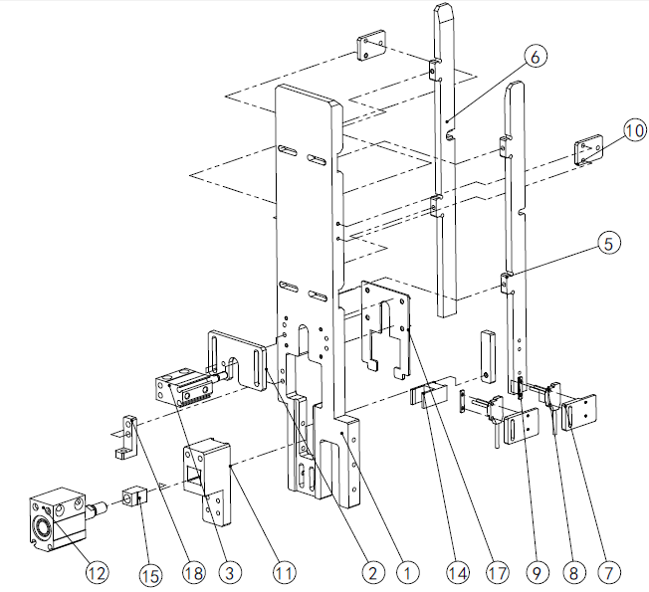
Chapter 2：Spare Parts List
Item No. | Part No. | Description | Qty
1 | 2001 | Tube mounted fly up front vertical plate | 1
2 | 2002 | Pre managed cylinder mounting plate | 1
3 | 2003 | MU12X10S_body | 1
4 | 2005 | Feida tube edge A | 1
5 | 2006 | Feida tube edge B | 1
6 | 2007 | EX-14A mounting base | 2
7 | 2008 | EX-14A sensor | 2
8 | 2009 | Inductor locking plate | 2
9 | 2010 | Adjusting special board | 2
10 | 2011 | Rear lower cylinder mounting base | 1
11 | 2012 | MU20X10S_body | 1
12 | 2014 | Lower managed support block | 1
13 | 2015 | Floating joint | 1
14 | 2016 | Lower managed support block | 1
15 | 2017 | ACT6R front baffle plate | 1
16 | 2018 | Front vertical plate reinforcing block | 1

Slide 9
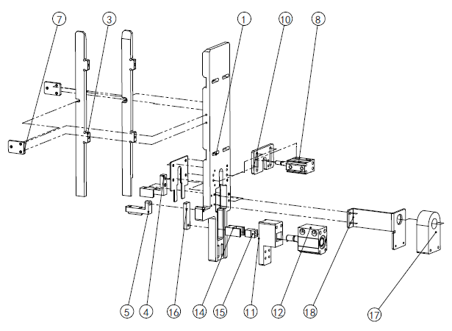
Chapter 2：Spare Parts List
Item No. | Part No. | Description | Qty
1 | 3001 | Stacked Tube Feeder back vertical plate | 1
2 | 3002 | Feida tube edge C | 1
3 | 3003 | Feida tube edge D | 1
4 | 3004 | tube vertical plate fixed corner A | 1
5 | 3005 | Fixed angle of tube plate | 1
6 | 3006 | ACTC6R rear baffle plate | 1
7 | 2010 | Adjusting special board | 2
8 | 2003 | MU12X10S_body | 1
9 | 3010 | Managed cylinder mounting plate | 1
10 | 2011 | Rear lower cylinder mounting base | 1
11 | 2012 | MU20X10S_body | 1
12 | 2014 | Lower managed support block | 1
13 | 2015 | Floating joint | 1
14 | 2016 | Lower managed strut | 1
15 | 3012 | DNA15- Dao Chuan | 1
16 | 3013 | Single tube inductor installation version | 1

Slide 10
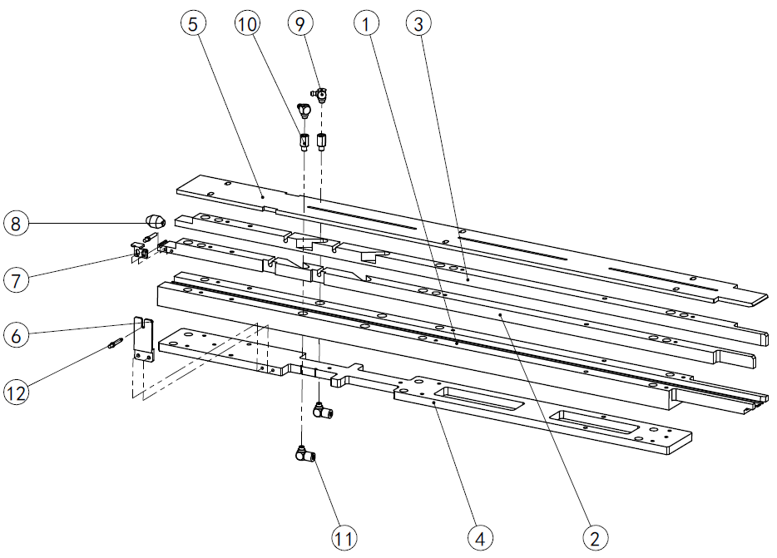
Chapter 2：Spare Parts List
Item No. | Part No. | Description | Qty
1 | 4001 | ACTC6R track | 1
2 | 4002 | ACTC6R material path A | 1
3 | 4003 | ACTC6R material path edge | 1
4 | 4004 | Bottom plate installation | 1
5 | 4005 | New material cover | 1
6 | 4006 | Pushing fiber | 1
7 | 4007 | Fiber-optic plate | 1
8 | 4008 | ACTc6R pushing head | 1
9 | 4009 | M-5ALN-6 | 2
10 | 4010 | Ventilatory mouth | 2
11 | 4011 | M-5HL-6 | 2
12 | 4012 | 310 optical fiber | 2

Slide 11
Chapter 2：Spare Parts List
Item No. | Part No. | Description | Qty
1 | 017 | Compacting seat | 1
2 | 5001 | Hinges A-B | 1
3 | 5002 | Bearing rotating shaft | 1
4 | 5003 | Rotary locking screw | 1
5 | 5004 | 683ZZ | 2
6 | 019 | Hinges B | 1
7 | 020 | Hinge connecting shaft | 1
8 | 021 | Hinges C | 1
9 | 022 | Toggle handle holder | 1
10 | 023 | Long connecting rod | 1
11 | 024 | Move the handle | 1
12 | 025 | Toggle seat locking block | 1
13 | 037 | Hinge connecting shaft A | 2
14 | 038 | Pin 4 x 20 | 1
15 | 039 | Spring pull column | 1
16 | 041 | Handle pin | 2
17 | 051 | Tightening screw | 1

Slide 12
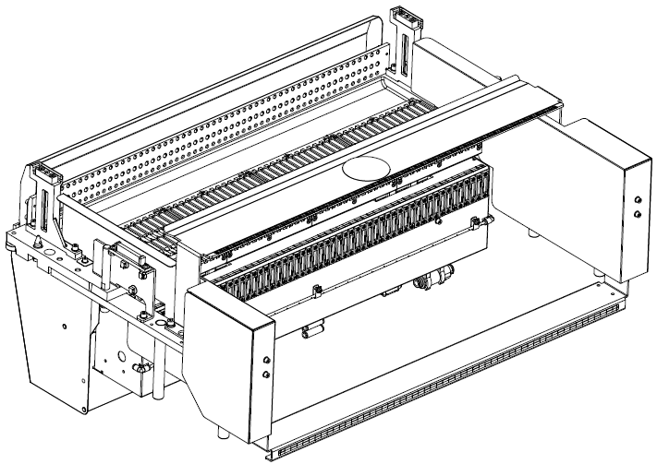
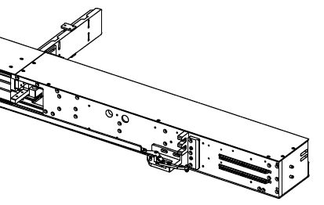
Chapter 3：Installed way
1
2
3
1-1
2-1
Fitting instruction：
1：Align the feeders 1-1 with the feeders 1, pin hole location mounting.
2：Aim the position key of feidong 2-1 at the position slot of feeder plate.
3：Pull the 3-1 clip tightly to the 3 position of the reach board.
3-1

Slide 13
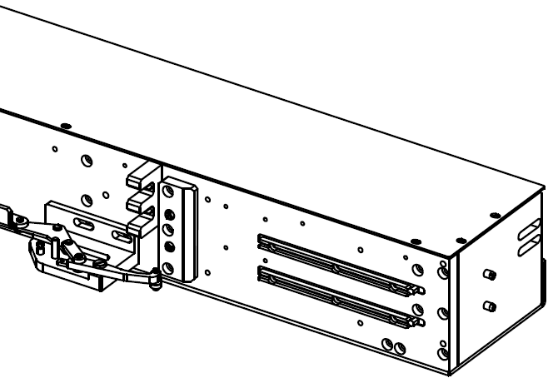
Chapter 3：Installed way
4-1
5-1
3-1
4：When the feeder-lock position lock is not tight: loosen two screws at 3-1 and move forward or backward, so that the round bearing at the front is stuck to the v-groove of feeder-plate 3, which is in contact with the cutting surface, and then tighten the screw.
5：The front and rear limit plate 4-1 is used to limit the front and rear position.
6:The positioning pin 5-1 at the back end of the feeder is used for positioning the back end of the feeder to prevent the left and right yaw of the feeder and ensure the vertical mounting position of the feeder.

Slide 14
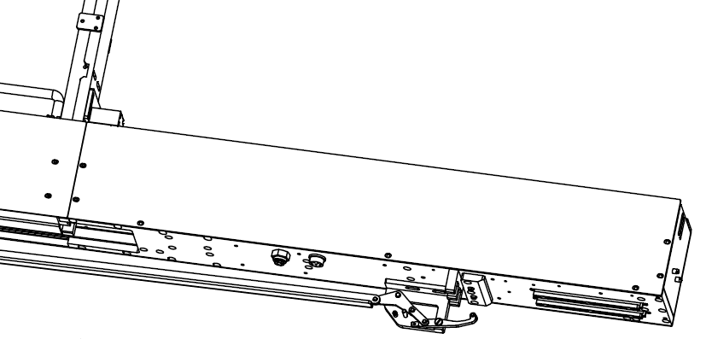
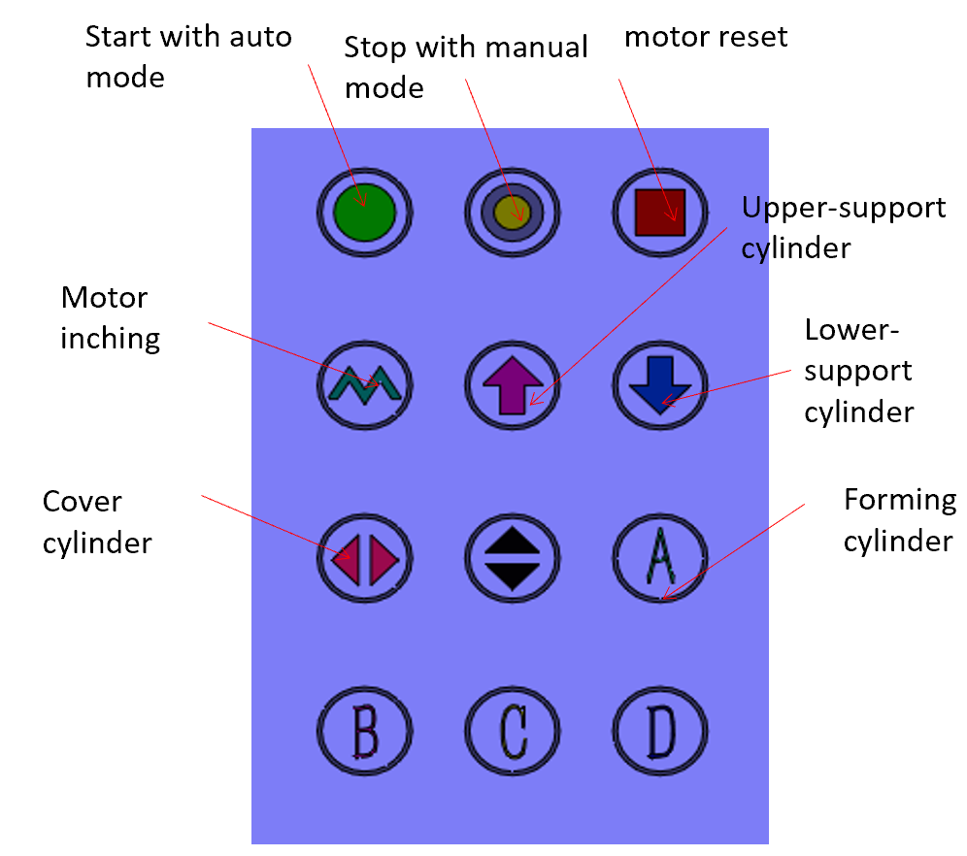
Chapter 4：Operation way
(1)：First lug in 24V,thenConnect air supply.
(2)：Put the component into the loading area.

Slide 15
Chapter 4：Operation way
(3)：Press the power switch, and if the switch become cool, it means the whole Feeder is charged with electricity.
(4)：Pressing the start button until running light is green, which means feeder can deliver the component automatically.
(5)：When it is connected with the mounter is successful, if there have component in the front-end it will send a signal to the mounter, and then pick the component.
（6）：Press the stop button until the device changes from the automatic state to the stop state.
（7）：When the running light of the device keeps flashing, it means an alarm, and then press the stop button for a long time until the running light stops flashing.

Slide 16
Chapter 5：Adjustment method
（一）：Optical fiber adjustment --Induction component
Fiber at mid section to return tube
Fiber optic amplifier at front end
Fiber at front-end induction component
Fiber optic amplifier at mid end
（1）：When the component at front end is in the right position but the lamp does not light up, then should increase the threshold by pressing "+" sign.As shown in A
（2）：When the component at mid end is picked and the indicator of the amplifier has not been extinguished,then should decrease the threshold by pressing " - " sign.As shown inA
（3）：When the component at mid end is removed away and the indicator of the amplifier has not been extinguished,then should decrease the threshold by pressing " - " sign.As shown inA
（4）：When the component at mid end is in the right position but the lamp does not light up, then should increase the threshold by pressing "+" sign..As shown in A

Slide 17
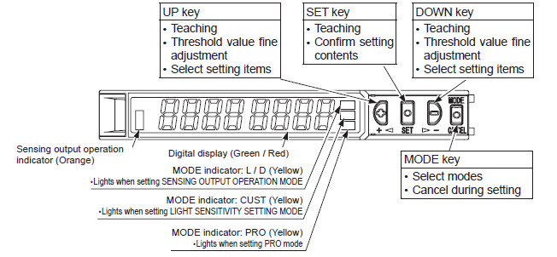
Chapter 5：Adjustment method
pilot lamp

Slide 18
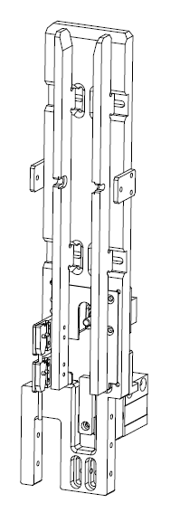
Chapter 5：Adjustment method
（二）：Position adjustment of upper and lower managed cylinders
1：When the components are easy to jam when entering the tubeline, the bottom cylinder should be adjusted upward or downward.As shown in A.
1：When the components are easy to jam when entering the tubeline, the bottom cylinder should be adjusted upward or downward.As shown in A.
2：When the inside air cylinder fails to push the component ,modify lightly the upper and lower positions of prop air sylinder.As shown inB.
2：When the inside air cylinder fails to push the component ,modify lightly the upper and lower positions of prop air sylinder.As shown inB.
3：When the empty tube is fall down not fluent, adjust the width of the baffle plate on the left and right sides bigger a little.As shown in C.
3：When the empty tube is fall down not fluent, adjust the width of the baffle plate on the left and right sides bigger a little.As shown in C.
4：When there have tube at the bottom and the tube is till continue falling out, instead of the bar draw back, then adjust the position of sensor (as D),placing the right position of tube, before that the indicator light of the sensor is on.
4：When there have tube at the bottom and the tube is till continue falling out, instead of the bar draw back, then adjust the position of sensor (as D),placing the right position of tube, before that the indicator light of the sensor is on.
6:When there are many tube in the back-end charging place, but each feed spring will push the component to the bottom, then the position of the sensor (as E) will be adjusted. Then when there are tube above, the sensor (as E)will light up.
C
C
E
B
D
A
18

Slide 19
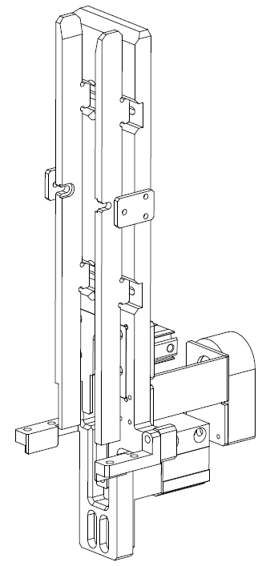
Chapter 5：Adjustment method
（二）：Position adjustment of upper and lower managed cylinders
C
B
A
（三）：When the length of the tube changes, adjust the back and forth spacing of the vertical plate.
Loosen the screws of the vertical plate after opening and tightening, change the position of the rear vertical plate before and after, adjust to the appropriate position, and tighten the screws

Slide 20
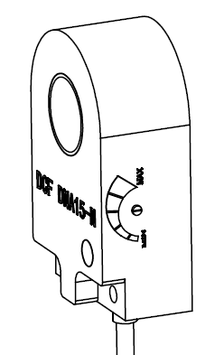
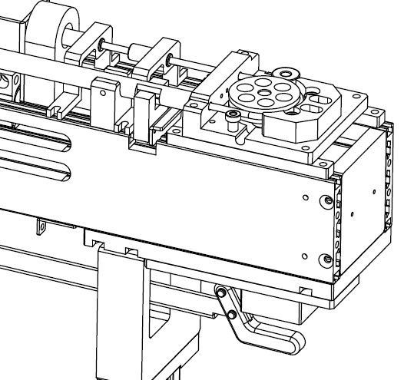
Chapter 5：Adjustment method
（四）：Adjustment method of push spring inductor
（1）When the spring does not leave the ring sensor, the light of the ring sensor should be on. If it is not on, turn the knob in the direction of Max.As shown in A.
（2）When the spring leaves the ring sensor, the light of the ring sensor is still on, and the knob is turned in the direction of Min.
Adjust sensor position
A
B
（五）：Adjustment method of limit inductor for push spring
（1）：When the spring moves inside the inductor, the light of the inductor is not on, the position of the inductor should be adjusted so that the light of the inductor is on when the spring is inside.
(2)：当弹簧离开感应器时，感应器应该灭灯，如果没有灭灯，则要上下调节感应器位置

Slide 21
Chapter 6：Treatment of feeder faults
一：the front end and the middle section fiber are adjusted according to the 5-1 debugging method, if the fiber amplifier is always on or often
If above parts are damaged, the following problems will occur：
（1）：Material has reached the feeding position is, but never back to the spring, has been to resist the material, the horse in the rotation. Or front not material, but not pushing spring action.
（2）：The material is pushed by the pushing spring every time before changing the tube.
二：After the sensor of the induction tube is adjusted according to 5-2-5, 5-5-6, if the sensor is still on or off, the sensor is damaged and a new sensor is replaced.
If above parts are damaged, the following problems will occur：
（1）：The damage of the lower sensor will appear: there is no material tube, the equipment does not alarm, the feed spring is always acted, or the tube change operation is always performed.
（2）：The damage of the upper sensor will appear: the material of each tube will be pushed to the bottom, and the tube change operation will be carried out all the time.
三：Magnetic switch for cylinder：
When the cylinder is in motion, the magnetic light is extinguish always, which means that the magnetic switch has been damaged and needs to be replaced a new one.
If above parts are damaged, the following problems will occur：
（1）：Feeder is in automatic operation,but it can not automatically replace the component tube.
（2）：When the air cylinder completes the operation of a replacement a empty tube, it does not operate at the second time.

Slide 22
Chapter 6：Treatment of feeder faults
四：Solenoid valve break down:
The cylinder does not move when the device is running automatically. In the manual state, press the button of the cylinder up and down, the cylinder does not move, you need to replace the solenoid valve.
五：Motor or drive break down：
The device is automatic, the motor does not perform the feeding action, press the motor on the panel to jog or the motor to reset. If the motor does not operate, replace the motor and the motor driver.
六：Spring origin sensor break down ：
The device returns to the original position and continues to run backwards until the spring is stuck, or the spring does not return to the original position, then the origin sensor is replaced.
七：Spring limit sensor break down：
When the spring reaches the limit position and the motor still does not stop, the limit sensor needs to be replaced.
八： The control board is broken or the IO board is break down：
After the device is powered on, there is no action, the operation panel does not respond, and all the sensors are not lit, then the control panel needs to be replaced.

Slide 23
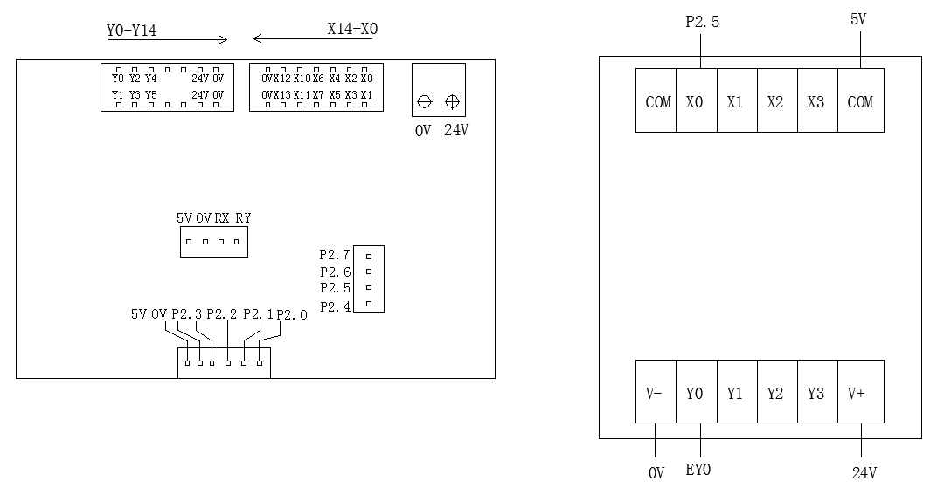
Chapter 7: Definition list of IO List & wiring
X0:Fiber of front end of component in position
X1:Upper tube sensor
X2:Lower tube sensor
X3:Origin point of fron & Pop-up air cylinder
X4:Mid-end Fiber
X5:Stop button
X6:Switch of Spring origin groove
X7:Origin point of back & Pop-up air cylinder
X10:前下托气缸动点
X11:后下托气缸动点
X12:弹簧极限槽型开关
X13:换管子槽型开关
P2.0:Automatic button
P2.1：Motor reset button
P2.2：Pop-up air cylinder button
P2.3：Pop-down air cylinder button
P2.4：motor inching button
Y0:Pulse Motors
Y1:马达方向
Y2: Solenoid valve of Pop-up air cylinder
Y3:Solenoid valve of Pop-down air cylinder
Y4:Out put of component in position
Y5:Running lights
EY0:Air-blown electromagnetic valve(P2.5)
EY1:压管气缸电磁阀(P2.7)
Communication port：
1： (DC+24V)
2： (GND)
4： (OUT)

Slide 24
Attachment--
Chapter 8：Instructions for use of fiber optic amplifier

Slide 25
